Slide 1


JR QR ANALYST ROLE ONLINE ASSESSMENT

Slide 2


JUNIOR QR ROLE
Prior to your next interview, we would like to test some of your skills that will be relevant to the Junior QR role.
Please explain or show us your work and how you arrived at your answers. Your process and how you approach these questions to arrive at your conclusions will give us a greater understanding of your skills than any particular answer or price.

Slide 3
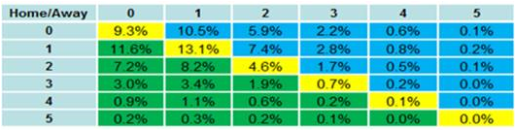
JUNIOR QR ROLE
Please answer the following question:
Looking at the table:
What is being displayed for this Ice Hockey match?
Which markets would you be able to compile?
Price those markets

Slide 4
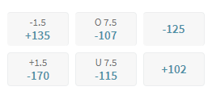
JUNIOR QR ROLE
Given the odds below, please calculate the margin or “juice” built into each odd

Slide 5
JUNIOR QR ROLE
Please select at least 2 of the following questions to answer:
Come up with 1-2 novelty markets (incl. pricing) for the upcoming NFL Season;
In the current baseball season, there has been some speculation regarding the mixing of “live” balls and “dead” balls (live ball meaning it’s favoring the batter, dead ball meaning it’s favoring the pitcher). How much do you think this affects the pricing of main markets and what would be some of the variables you would consider exploring to prove or disprove this hypothesis?
Determine the odds for who will have the most receiving yards by the end of the NFL season, Stefon Diggs or Tyreek Hill.

Slide 6
JUNIOR QR ROLE
Attached is a .csv file with a sample dataset. Please answer the following questions using Python. Please write and submit your code in a Jupyter notebook file. Please include the output for each question in the Jupyter notebook file.
The dataframe attached has records of 1,000 objects with 3 columns:
shape - square, triangle (equilateral) or circle
color - blue, red, green or yellow
area - area size in square inches
Draw a boxplot showing the area size distribution for each shape.
Calculate the mean, max, and standard deviation of the area size of each color.
What is the average area size of a yellow square?
Which shape is most likely to be green?
Given the fact that the object is red, with an area size larger than 3,000 - what are the chances the object is a square? a triangle? a circle? (give an explanation of how we would convert those probabilities to odds)
Create a dataframe, table, or list to show the following:
The proportion of red objects within the shape
The proportion of blue area out of the shapes total area (sum of square inch blue area of the shape over sum of all shape size)

